Slide 1
CS3244 Project Presentation
Group 35
Tan Kel Zin | Tan Wei Xin | Amon Maria Kasper
Gan Hao Cheng, Keith | S Dinesh Raj
Notes:
Greetings everyone,
My name is Dinesh. My teammates are Keith, Amon, Wei Xin and Kal zin. We are group 35 and we are here to present our Machine Learning Project.

Slide 2
Given Two Questions, are they the Same?
Are these Two Questions Identical?
Quora Question Pairs
Question 1 | Question 2 | Label
What is the step by step guide to invest in share market in india? | What is the step by step guide to invest in share market? | 0
Notes:
The dataset which our group used was the Quora Question Pairs. In this dataset, we are given thousands of data instances where each instance will have 2 questions from the Quora website and 1 label.
The objective of this project is to see
“Given Two Questions, are they the Same? Are these Two Questions Identical?”

Slide 3
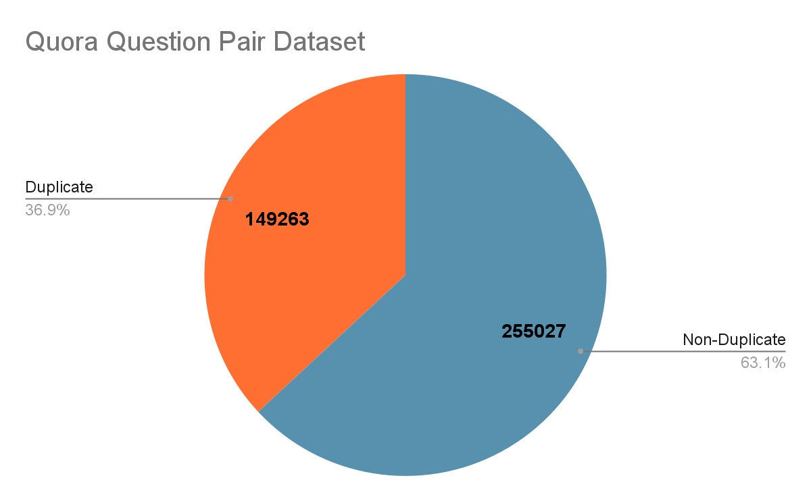
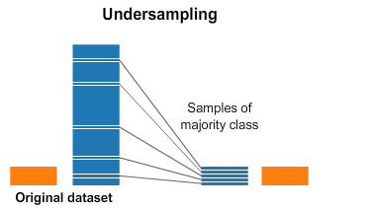
Dataset
Split into
Train (80%)
Test (20%)
Notes:
The first thing we did was to try and understand the distribution of the dataset. After plotting a simple pie chart, we identified that non-duplicate instances dominated duplicate instances as they represented about 63% of the dataset compared to the 37% of Duplicates. We split the dataset into 2 different sets by using stratified k fold. Using a k value of 5, we divided the data by an 80 to 20 ratio. The larger set was used for training the model whereas the smaller set was used for testing the model. In efforts to mitigate the imbalance in the training dataset, we tried to undersample the training datasets to reduce any form of bias of the model but we realized the difference was minimal. Therefore instead of undersampling, we used sklearn methods to balance the data classes in certain models by modifying their weights.

Slide 4

Data cleaning
Remove
Stop words, Special characters, Punctuations
Null instances, White spaces
Standardise
Stemming
Lemmatization
Notes:
With that being done, we then proceeded to clean the training dataset. We did this by removing the stopwords, special characters, punctuations and white spaces completely from the questions. We also removed null instances that were identified. After removing all these uninformative words, we standardized all the instances using stemming and lemmatization. We did this by trimming words without contextual knowledge, lower casing all letters and converting words with similar meaning to its lemma form as identified in a dictionary.

Slide 5
Sentence Embedding
Sentence -> Vector
Notes:
Next we wanted to explore how to convert these sentences which were in plain english to numerical vector representation so that the computer can understand and process these inputs. Therefore we explored 3 famous NLP embedding techniques in this project

Slide 6
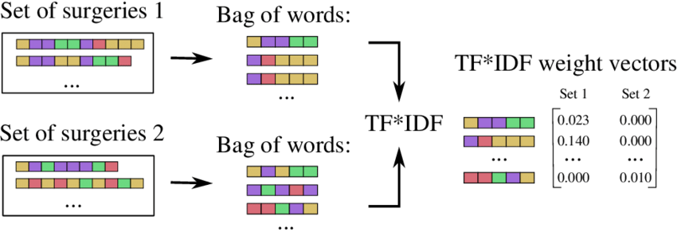
TF IDF
Term frequency - Inverse document frequency
Bag of words (BoW)
Based on training dataset
Notes:
Firstly, term frequency inverse document frequency also known as TF IDF. This method is built upon the concept of Bag of words. This method basically forms a feature vector based on the corpus of all the standardized questions from our training data. Through this method, each question is transformed into a feature vector that signifies how informative or unique the words in the questions are compared to the entire dataset.

Slide 7
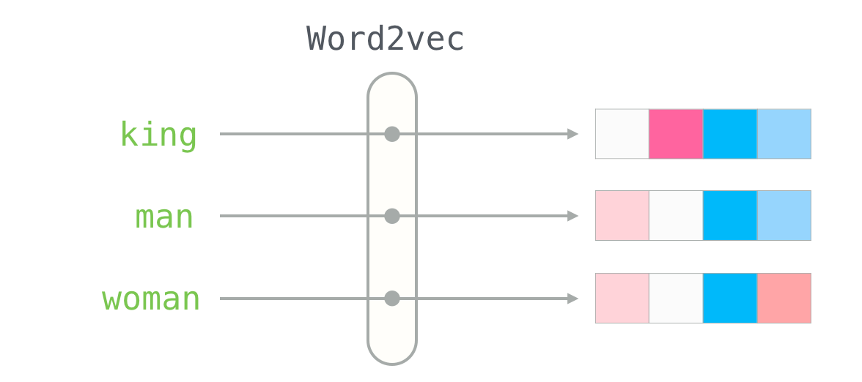
Word2Vec
word2vec-google-news-300
Pretrained Neural network model
Google News dataset (100 billion words)
Convert a word to a vector
Words with similar in meaning, Closer together
Notes:
The second embedding technique we tried was Word2vec. The model we used was word2vec-google-news-300. It is a neural network model pre-trained on a part of the Google News dataset of about 100 billion words. The model contains 300-dimensional vectors for 3 million words and phrases. This model assists to form vectors for words comparing it against similar words. We used this method to create vectors for each standardized question by taking each word from the questions and concatenating together their vector representation.

Slide 8
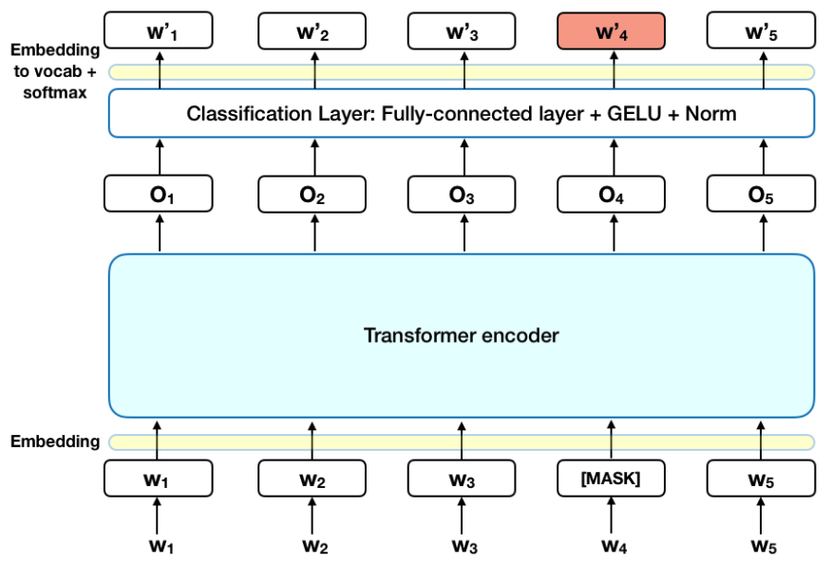
BERT
Quora-distilbert-multilingual
Trained on Quora Duplicate questions dataset
Semantic correlation between 2 sentences
Different languages
Notes:
Thirdly, the Bert model also known as Bidirectional Encoder Representations from Transformers. The bert model which we selected is called Quora-distilbert-multilingual. It is a deep learning model which is pre-trained on Quora duplicate questions datasets. Bert basically converts a sentence into a 786 dimensional vector capturing the meaning of the sentence as accurately as possible.
According to online sources, BERT being the most advanced and recent NLP algorithm, it has the best ability to capture the semantic meaning of a sentence in the form of a feature vector compared to both TF IDF and Word2Vec.

Slide 9
Feature Engineering

Slide 10
Features
Basic Features
is_equal
is_same_category
question_len
shared_word_percentage
Sequence-based Features
longest_common_subsequence
longest_common_substring
gestalt_ratio
Character-based Features
levenshtein_ratio
jaro_ratio
jaro_winkler_ratio
Token-based Features
bigram_similarity
trigram_similarity
Bag of Words Features
count_similarity
tfidf_similarity
Vector-based Features
word2vec_similarity
word_mover_similarity
quora_distilbert_similarity

Slide 11
Basic Feature – is_equal
Binary feature indicating if two questions are equal to each other after preprocessing
There are 27,977 out of 403,970 instances (6.9%) where two questions are equal
Out of these 27,977 instances, 20,851 are duplicates (74.53% accuracy)

Slide 12
Basic Feature – is_equal
Advantage
Straightforward way to identify duplicate questions after preprocessing
Instance 175 (is_duplicate=True, is_equal=True)
Question No. | Question 1 | Question 2
Original | Which is the best fixed income fund? | What is the best fixed income fund?
Preprocessed | best fixed income fund | best fixed income fund

Slide 13
Basic Feature – is_equal
Disadvantage
Accurate only about 74.53% of the time because preprocessing may remove important stop words with semantic meaning (e.g., “again”)
Instance 302 (is_duplicate=False, is_equal=True)
Question No. | Question 1 | Question 2
Original | How do I start writing again? | How do I start writing?
Preprocessed | start writing | start writing

Slide 14
Basic Feature – question_len
Normalised feature indicating the ratio of the length of the shorter question to the length of the longer question
There are 61,685 out of 403,970 instances (15.2%) where question_len < 0.5
Out of these 61,685 instances, 80.3% are not duplicates

Slide 15
Basic Feature – question_len
Advantage
Two questions are unlikely to be duplicates if their question lengths differ significantly
Instance 52 (is_duplicate=False, question_len=0.15)
Question No. | Question 1 | Question 2
Preprocessed | Nd she is always sad? | Aerodynamically what happens when propellor rotates?

Slide 16
Basic Feature – question_len
Disadvantage
Without consideration of the words in the question, question length itself is not indicative of similarity
Instance 24 (is_duplicate=False, question_len=1.00)
Question No. | Question 1 | Question 2
Preprocessed | mean time look clock number | time day clock hand overlap

Slide 17
Sequence-based Feature – longest_common_substring
Advantage – take into account the relative ordering of words
Disadvantage
Synonyms or filler words will result in a false negative
Instance 1449 (is_duplicate=True, longest_common_substring=0.30)
Question No. | Question 1 | Question 2
Preprocessed | type wildlife native turkey | animal native country turkey

Slide 18
Sequence-based Feature – gestalt_ratio
Based on the Ratcliff/Obershelp pattern recognition algorithm
Advantage
Helps to mitigate the disadvantage of the longest common substring algorithm by recursively matching characters in the non-matching regions
Disadvantage
Cannot take into account semantic meaning of named entities, which can alter the meaning of the question significantly with just one or two words

Slide 19
Character-based Feature – levenshtein_ratio
Normalised metric that measures the minimum number of edits that you need to do to change one sentence into the other
Advantages
Can account for synonyms in similar sentences and minor sequence variations
Instance 48641 (is_duplicate=True, levenshtein_ratio=0.81)
Question No. | Question 1 | Question 2
Preprocessed | group discussion topic interview | topic group discussion interview

Slide 20
Character-based Feature – levenshtein_ratio
Disadvantage
Could easily lead to false positives if the sentences differ in a word with significant semantic meaning
Instance 98563 (is_duplicate=False, levenshtein_ratio=0.82)
Question No. | Question 1 | Question 2
Preprocessed | led rise mongol empire | led fall mongol empire

Slide 21
Token-based Feature – bi/tri-gram_similarity
N-gram similarity metric that computes sentence similarity by the n-gram distance between the two questions
Advantage
Account for phrases in sentences
Instance 19692 (is_duplicate=True, bigram_similarity=0.85)
Question No. | Question 1 | Question 2
Preprocessed | new york city greatest city world | new york greatest city world

Slide 22
Bag of Words Feature – count_similarity
Cosine similarity between two questions that have been vectorised using a Bag of Words model
Advantage
Representation of a sentence as a vector and using cosine similarity to estimate similarity
Disadvantage
Results in a sparse matrix that suffers from the curse of dimensionality

Slide 23
Bag of Words Feature – tfidf_similarity
Cosine similarity between two questions vectorised using a TF-IDF model
Advantage
Place greater weight on uncommon words
Instance 372876 (is_duplicate=True, tfidf_similarity=0.91)
Question No. | Question 1 | Question 2
Preprocessed | best private job government job | government job better private job

Slide 24
Vector-based Features – word2vec, BERT, etc.
Cosine similarity between sentence embeddings generated by a deep neural network
Advantage
Automatic feature engineering is able to more accurately capture the semantic meaning of sentences by using pre-trained models
Disadvantage
Hard to explain why two questions are similar based on a sentence embedding

Slide 25
Classical ML Models
Notes:
Let us now use our engineered features to build classical ML models such as decision tree, random forest, logistic regression, SVM, knn, naive bayes and XGBoost

Slide 26
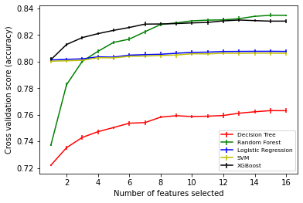
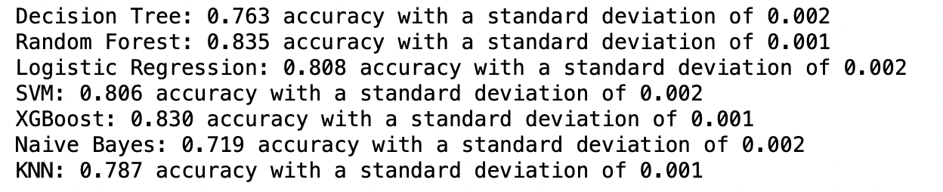
Performance under Cross-Validation and RFE
Notes:
To do this we test our models using cross validation on an undersampled dataset and also perform recursive feature elimination to see our model performance for different number of features.
We observe that Random Forest and XGBoost perform the best on our problem with around 83-84% accuracy scores, while Naive Bayes performs significantly worst with around 72% accuracy.
Regarding RFE we observe Logistic Regression and Linear SVC being very stable regarding feature elimination, while we observe significant drops in accuracy for decision tree, random forest and XGBoost after keeping only 8 features.

Slide 27
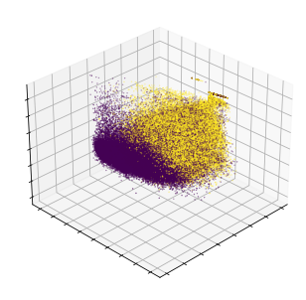
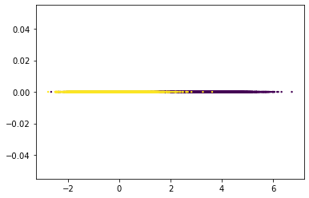
Why do models behave differently?
Feature invariance of SVM and logistic regression: data sufficiently separable (see PCA and LDA results)
Decision Tree and Random Forest accuracies asymptotically increase with features
Decision Tree tends to overfit -> accuracy suffers!
PCA (top) and LDA(bottom) Results: data seems to be to a satisfying degree linearly separable
Notes:
So why do we observe the previous observations. With our Bert extracted feature our data becomes already sufficiently linearly separable, which is why adding more features to our model doesn’t improve on model accuracy in the SVM and logistic regression model. We will cover BERT more extensively later in this presentation. On the right we can see the results of our principal component analysis PCA and linear discriminant analysis LDA, which confirms this hypothesis. Decision Tree and Random Forest bisect space into smaller and smaller elements, which is why adding more features corresponds to increasing accuracy. Random Forest vastly outperforms a single Decision Tree since a single Decision Tree tends to overfit the data while Random Forest avoids overfitting by using many decision trees on subsets of datasets and taking a majority vote on prediction. That is also why if only one feature is used no big difference between decision tree and random forest is to be expected.
Naive Bayes performs worst as its underlying principles are not suited for our problem!

Slide 28
Feature Analysis - Is Feature Importance Model-Invariant?
Notes:
Let us now take a look at feature importance and aks the question if feature impotence is model invariant.

Slide 29
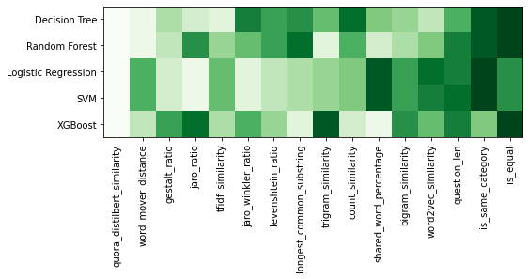
Feature importance in different models
Feature importance clearly varies among models
Clear correlation between logistic regression and linear SVC observed
Bert vector similarity most important across all models, while simple features (is_equal, is_same_category, question_len) are consistently ranked lowest
Notes:
We extract feature importance using our recursive feature elimination results. We observe that feature importance clearly varies among models with lighter color symbolising greater importance. Bert vector generated cosine similarity is among all models consistently ranked highest, while simple features like sentence equality, same question word or the difference in question length is consistently ranked lowest among all models. This is reasonable as these trivial features are not expected to give deep insights regarding the similarity of two questions. Furthermore we observe that feature importance is almost equivalent between logistic regression and linear SVM. Decision Tree, Random forest and XGBoost show no such clear correspondence

Slide 30
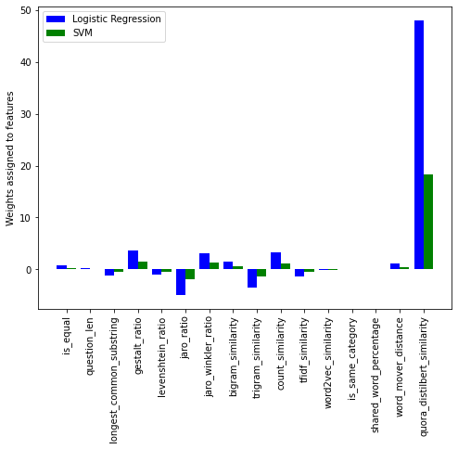
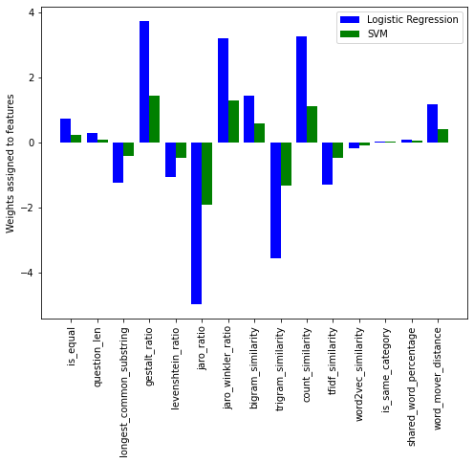
Weights in logistic regression and SVC
Notes:
Let us take a look at the weights in logistic regression and linear SVM. We observe that the logistic regression weights seem to be consistently a constant factor x larger for all features than those of SVM. The reason for that could be that logistic regression and linear SVM both try to find a separating hyperplane but SVM has more constraints regarding that hyperplane such that logistic regression tends to overfit the problem resulting in consistently larger weights.

Slide 31
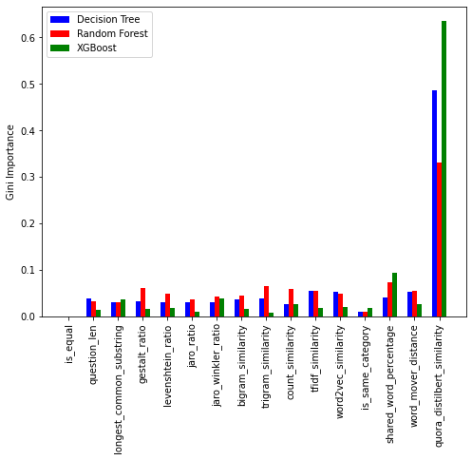
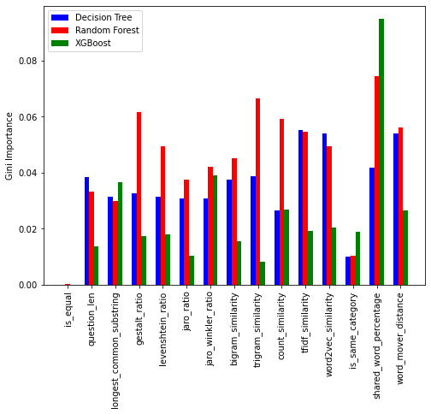
Gini importance in decision tree, random forest and XGBoost
Notes:
Lets now take a look at the Gini Importances in Decision Tree, random forest and XGBoost, which is a measure of the information gain for a given feature. We observe that the variance of decision tree importances (0.012) is more than double that of random forest (0.0015), which again is a expected result as decision tree tends to overfit and thus depends highly on a specific set of features. This gives rise to a generally higher variance

Slide 32
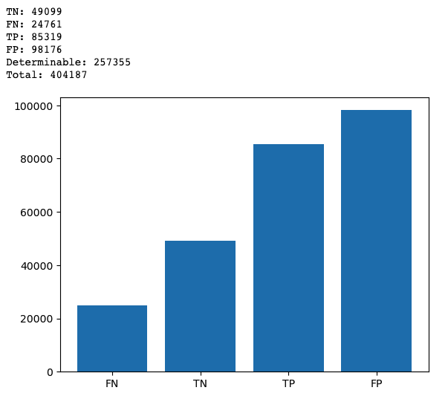
Same Category?
Low False Negatives
Different keywords generally would mean different question, as expected
High False Positives
Same keyword but not duplicate, expected since we ignored the semantic meaning
Availability as a feature is not high
Not every questions start with one of these keywords.
E.g. Method to find separation of slits using fresnel biprism?
These were ignored

Slide 33
Finding the best K in KNN
Notes:
One of the first questions is how do we determine what value of K is best for the KNN model for this problem?

Slide 34
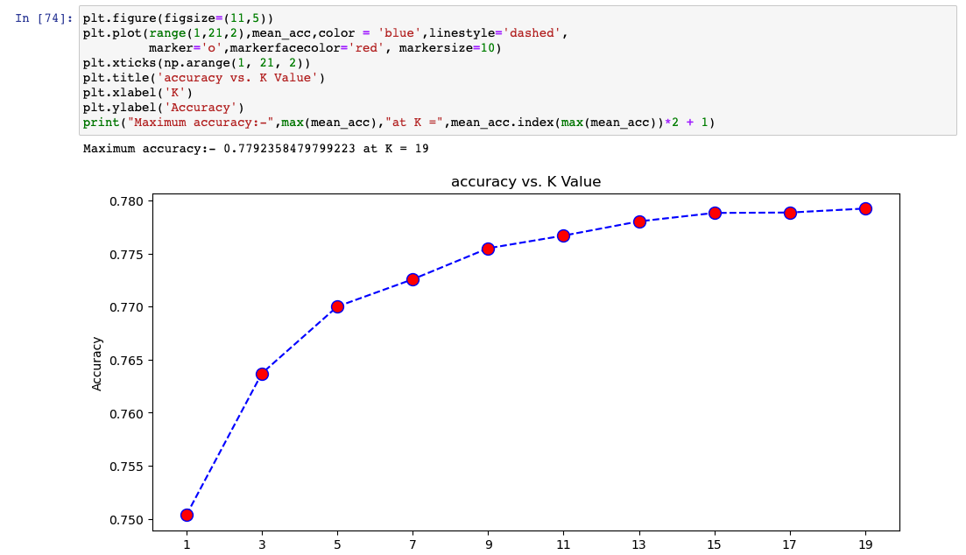
Hyperparameter tuning for KNN
Plateaus at K=15
https://towardsdatascience.com/how-to-find-the-optimal-value-of-k-in-knn-35d936e554eb
Notes:
In this case we tried different value of K and plotted their accuracy.
In our instance, we find that starting from K = 15 onwards it plateaus, and hence that is the K that we have picked.
We could pick a higher value of K but we would risk the model underfitting and hence not being able to generalise well.

Slide 35
Does ensembling help?
Notes:
Another question that we have looked into is does ensembling help?

Slide 36
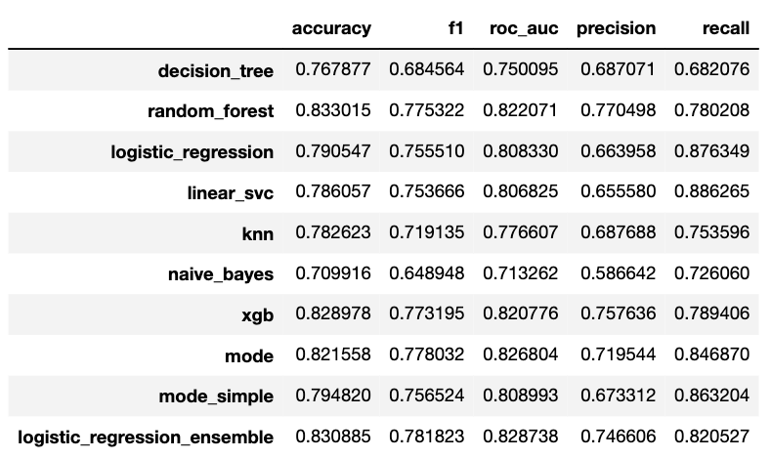
Does ensembling help?
Yes and no, it depends
Improves result on simple models
Notes:
It turns out to not be as straightforward as we have thought!
If we are just looking at the simple models that we have learned in class, which is the decision tree, logistic regression…, we see that taking the mode does indeed improve the accuracy. In particular for naive bayes in this case with a 9% improvement.

Slide 37
Does ensembling help?
Using more sophisticated ensembling method helps
Notes:
So how can we alleviate this?
Realise that ensembling all the predictions to give a classification is itself a classification problem! We can do better than just taking the majority. Indeed, feeding the various predictions into logistic regression model helps with improving accuracy as we can see here.

Slide 38
Does ensembling help?
Might make things worse for more advanced models
Notes:
However, looking at more advanced model such as random forest as well as gradient boosted decision tree, we see that the accuracy actually went down, they would’ve actually performed better without ensembling.
This is most likely due to the weaker models being the bottleneck, which might override the decision of the more sophisticated model.
Moreover, seeing the increase from just introducing two models, it suggests that in around 3% of the cases the decisions were quite split between the simple models.

Slide 39
Conclusion: Ensembling does help*
* depending on your models and ensembling method
Notes:
So, the conclusion is that yes ensembling does help, but one needs to be careful on what kind of models are we ensembling on, and depending on that, we might need to more sophisticated ensembling method as we have seen here.

Slide 40
Does normalization affect all models?
Notes:
Another question we have looked at is whether or not normalisation affects all the model.

Slide 41
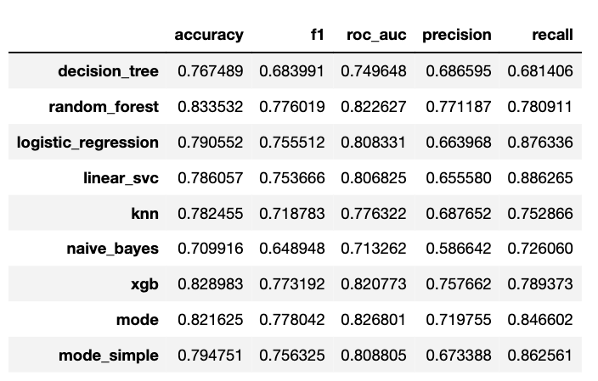
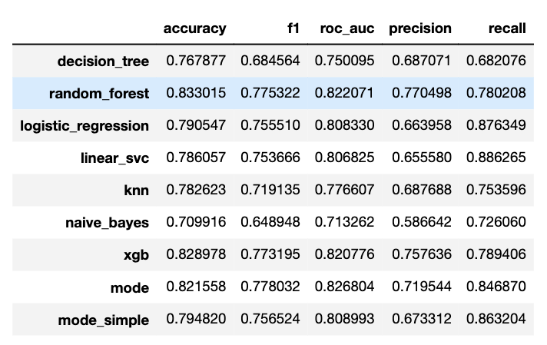
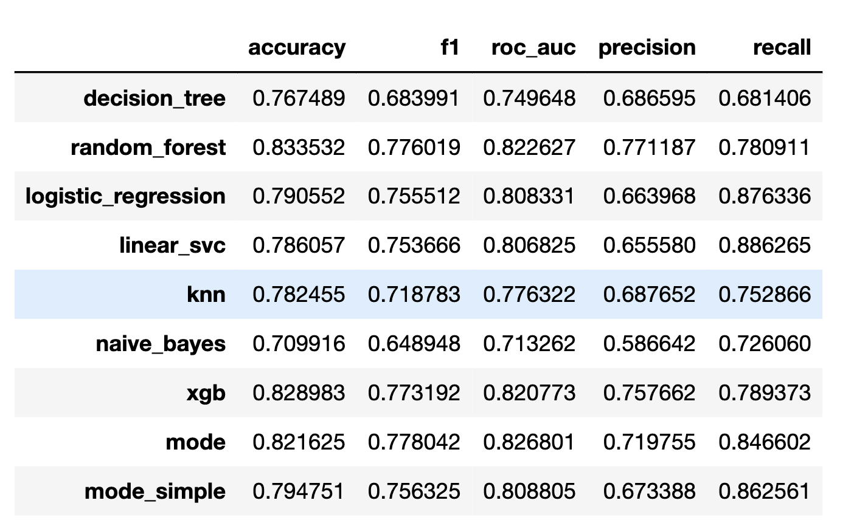
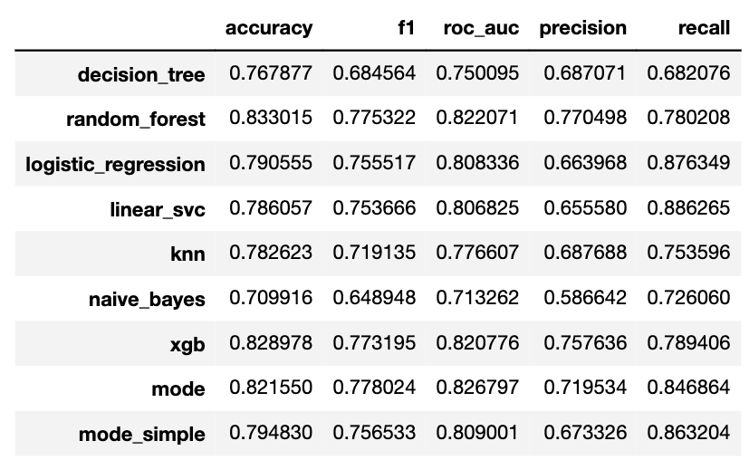
Does normalization affect all models?
Distance based models will be affected
Notes:
From what we have learned, we can expect that the distance based models would be affected, for example KNN in this case.
And indeed this is what we observe.
What is a bit more surprising however, is that decision tree and random forest are being affected to a similar degree.
If we assumed the decision tree splits the feature based on best cutoff such as maximum information gain, we would expect the accuracy to still be the same since the cutoff should just be scaled accordingly.
So this tells us that it once again depends on how the model is implemented in practice, and we should verify our assumption accordingly.

Slide 42
Artificial Neural Network

Slide 43
Construction
Define F(x) = v, where F is the bert sentence embedding model
Define NN(v) = y, where NN is a neural network model
1. NN(F(s_1) - F(s_2)) - Test Accuracy: 84.64
2. NN(F(s_1) || F(s_2)) - Test Accuracy: 83.97
3. NN(F(s_1 || separator || s_2) - Test Accuracy: 81.15

Slide 44
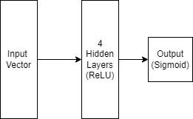
Layers
We have tuned the neural network based on their performance
Hidden layer with ReLU activation performs the best.
The neural network overfit easily when we the number of layers is more than 4

Slide 45
Techniques
Overfitting Prevention
Stop early by measuring performance in validation set
Drop-out layer
Reducing number of layers
ReLU as all the activation function except for last layer (Sigmoid)
Binary cross entropy as loss function

Slide 46
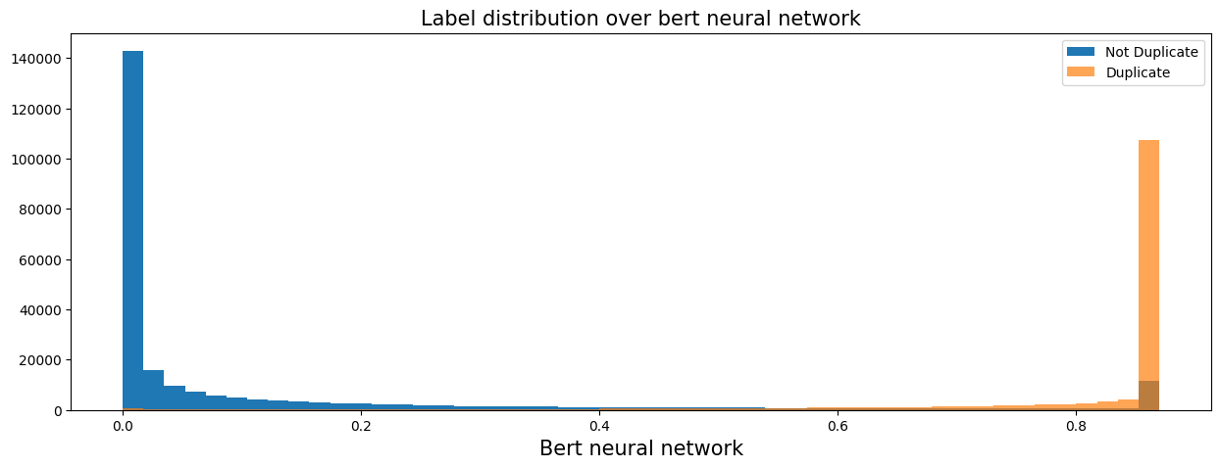
Label Distribution

Slide 47
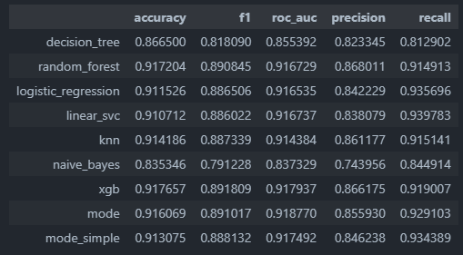
Ensemble
Our best model so far

Slide 48
Conclusion

Slide 49
What Have We Learned?
The importance to extract relevant features
The skills to visualize the importance of feature with suitable diagram
Popular sentences embedding model (Bert) performs really well
K-fold cross validation are really useful for Model evaluation

Slide 50
Citations & Resources
https://machinelearningmastery.com/tutorial-first-neural-network-python-keras/
https://medium.com/@drcjudelhi/bert-fine-tuning-on-quora-question-pairs-b48277787285
https://towardsdatascience.com/how-to-find-the-optimal-value-of-k-in-knn-35d936e554eb
https://machinelearningmastery.com/cross-validation-for-imbalanced-classification/

